Slide 1

Final Year Project Interim Presentation
By Jasper, Mei Xuan, Donovan, Mabel & Nurasilah

Slide 2
Agenda
Introduction
Objectives
Project TImeline
Analysis of Power Bi against Tableau
Data Mining
Data Analysis
Prototype Demonstration

Slide 3


1.
Introduction

Slide 4
Background of the Cafe industry in Singapore
Consumer preferences
Target market
Thriving market
Increased competition
Value proposition
Why we think the business is viable
Notes:
Consumer preferences have shifted towards healthier food choices
Main consumers of salads are corporate employees
Caffeine is the world’s most popular drug
Increased competition in the industry
Value proposition of The Caffeine Experience
Why we think the business is viable

Slide 5

2.
Objectives

Slide 6
Objectives
What can The Caffeine Experience expect from this team?
Key details of competitors
Price per pax
Distance from MRT
Must try items
Avg. Rating & no. of review
Helps to make intelligent business decisions
Notes:
Price? Location? Must try
Key features of competitors:
Distance from MRT
Price per pax
Must try items
Average review

Slide 7

3.
Project Timeline

Slide 8
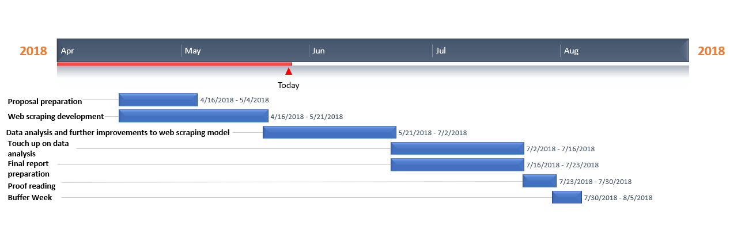

Slide 9
Task List
Project Planning
Proposal Preparation
Acquiring skills on Python fundamentals
Developing a web scraper
Clean and process data
Analyse the processed data
Final Report Writing
Final Presentation Preparation

Slide 10

4.
Analysis of Power BI against Tableau
Notes:
Our group have done a comparison between power Bi and tableau to let you decide on which software suits your needs better.

Slide 11

Pros:
Reasonably priced (offers free version, paid version is $9.99 per user a month)
Good integration within Microsoft tools
Continual development
Ease of usage for excel users due to similar tools
Extensive visualising choices
Comprehensive database connectivity
Cons:
Challenging to learn (for non-excel users)
Trouble handling large data sources
Highly complex
Poor customization
Lack of data processing capabilities
Only offers monthly-subscription and not licensing

Slide 12

Pros:
Easy to use (for non-analyst)
Visually appealing
Great performance
Ability to connect to multiple data sources
Flourishing community
Mobile support
Cons:
Expensive (professional edition $70 per user a month)
Stringent pricing, not priced to customer’s needs.
Security concerns
Poor Scalability
Integration to IT landscape issues
Data warehouses are expensive to build and maintain
Notes:
Data warehouses which are expensive to build and maintain, are usually accompanied with Tableau to achieve its fullest potential

Slide 13
Comparison
Both have great integration with other Office 365 tools
Power BI has more extensive charting capabilities
Tableau more visually appealing and offers wider range of visual customisations
Both comes with potential hurdles
Complexity and steep learning curve for Power BI
Complex functions of Tableau
Software training needed for user
resource consuming
Notes:
considering the needs of The Caffeine Experience being a start-up company with a stringent budget, Power BI being the more affordable choice, being $60 cheaper, is recommended by our team.

Slide 14

5.
Data Mining

Slide 15
Why Online Review Site ?
Data Mining
Website
Potential customers looks at review site before making a decision
Platform for companies to gain insights on customer satisfaction
Food Discovery Platform
Word of Mouth
Food Blogs

Slide 16

Why Burpple ?
Data Mining
Website
Singapore based company that was launched in May 2012
Growing food reviews platform akin to Yelp , Zomato.
In 2016 ,
5 Million People & 3 Million Reviews
(Singaporean & Foreigners)
Notes:
5 million users?

Slide 17
What is the criteria of the data?
Data Mining
Filter
Cafe: ‘Tanjong Pagar Cafes’
Near Tanjong Pagar and Central Business District (CBD) Area
Competitor
Same target customers
More than 5 Reviews
Variety of reviews
More representative of the customer base
Reviews dated in 2016 ~ 2018
Recent
Cafes menu may change overtime
Notes:
Need string divided between direct and indirect.
Other than location, are you going to separate by salad or coffee or both?

Slide 18
How does the output look like?
Data Mining
Output
3 Outputs:
Individual Cafe’s Data
Cafe’s Must Order Item
Respective Cafe’s Reviews
Notes:
3 slides: (3 outputs)
The header? , example?

Slide 19
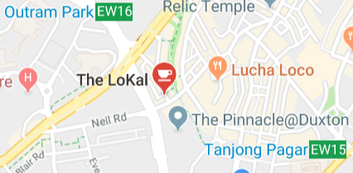
Individual Cafe’s Data
Cafe Name
Neighbourhood
Latitude
Longitude
No. of Reviews
Price per pax
The Lokal
Outram Park
1.278
103.84
845
$25
Location

Slide 20
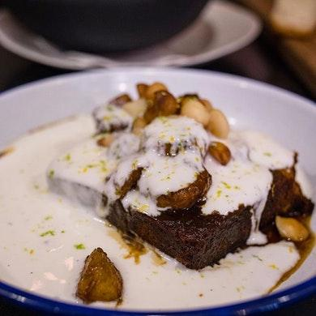
Cafe’s Must Order Item
Cafe Name
Image URL
Item Name
No. of Reviews
Price
The Lokal
https://burpple-1.imgix.net/foods/
Toasted Banana Bread
56
$16
Visualisation

Slide 21
Respective Cafe’s Reviews
Cafe Name
Date
Title
Review
The Lokal
Apr 20, 2018
Indulgent Mornings
I loved how fluffy the French toast in and how well it went with the citrusy flavours, but the portion was a little too much of an overkill.
Insights

Slide 22
Terms & Conditions
Data Mining
Constraints
Websites:
Yelp, HungryGoWhere
Do Not Allow:
Use of any automated device, process or means to access, retrieve, scrape, or index any portion of the Site

Slide 23
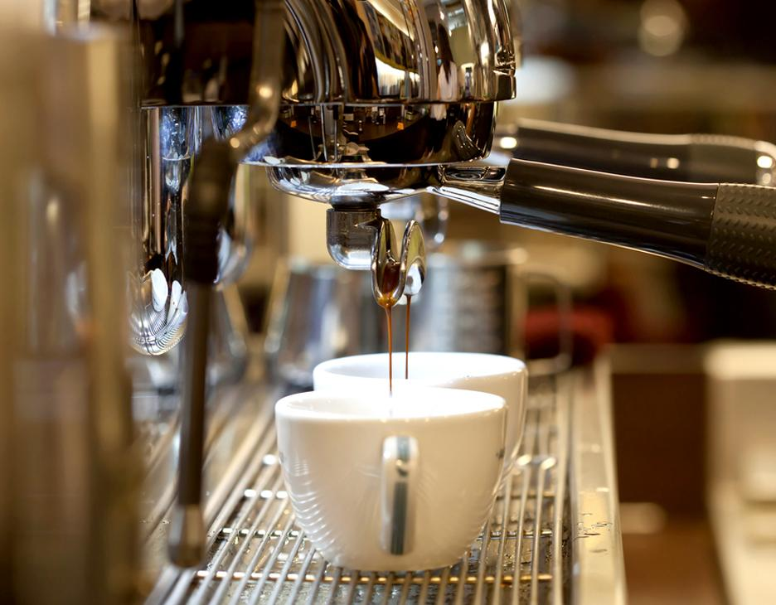
6.
Data Analysis

Slide 24
Data Analysis
What to do?
Clean
Analyse
Insights
Removing:
Punctuation
Stop words
irrelevant data
Keywords
Mapping
Filtering
Methods:
S & W
Spending
Ratings
Compare:
Notes:
I feel like with this slide, I can talk about the insights without need a slide for that.
Stop words = common

Slide 25
Direct
Others
Data Analysis
How are we analysing?
Geography - Mapping
Tanjong Pagar
Rest of CBD
Keywords - TF-IDF
E.g. “Coffee”, “Salad”
Main focus on other food items
Notes:
Keywords based on reviews/ must try food items

Slide 26
Data Analysis
Methodology
TF-IDF
Keywords
Mapping (with excel)
Shows geographical location of all the cafes on a map

Slide 27
TF-IDF
Data Analysis
Methodology
Term Frequency (TF)
Inverse Document Frequency (IDF)
Less Emphasis on Common Terms
E.g. “That”, “is”, “was”
More emphasis on important words
E.g. “Coffee”, “Salad”
Notes:
No need to include the formula and stuff, just mention the bottom part and say what kind of output.

Slide 28
TF-IDF
Data Analysis
Methodology
“
For example,
The quick brown fox jumps over the lazy fox on the grass
The quick brown fox jumps over the lazy fox on the grass
The quick brown fox jumps over the lazy fox on the grass
”
However they are common words
Looks for common, but fewer words
Output: fox
Notes:
No need to include the formula and stuff, just mention the bottom part and say what kind of output.

Slide 29
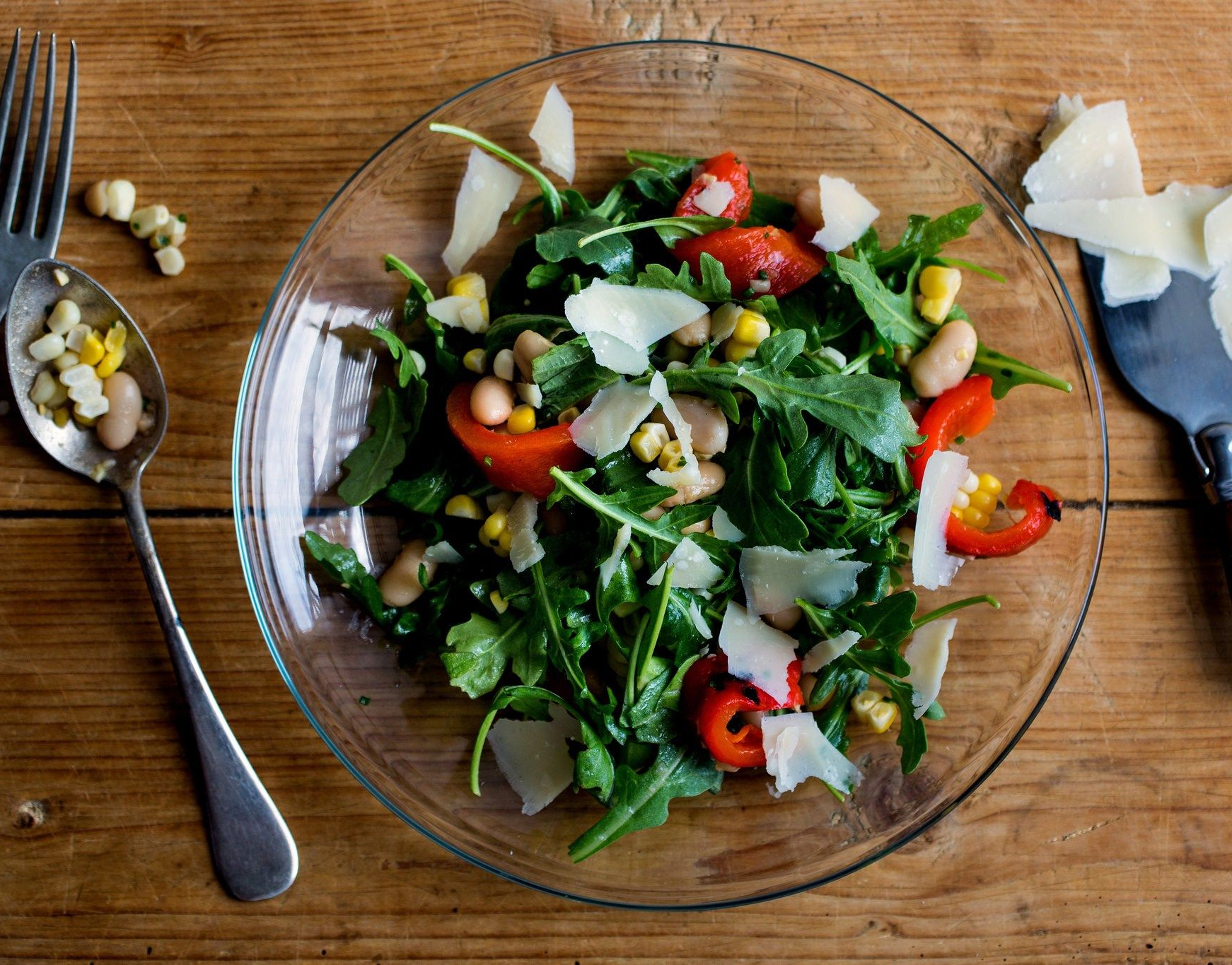
7.
Prototype Demonstration

Slide 30
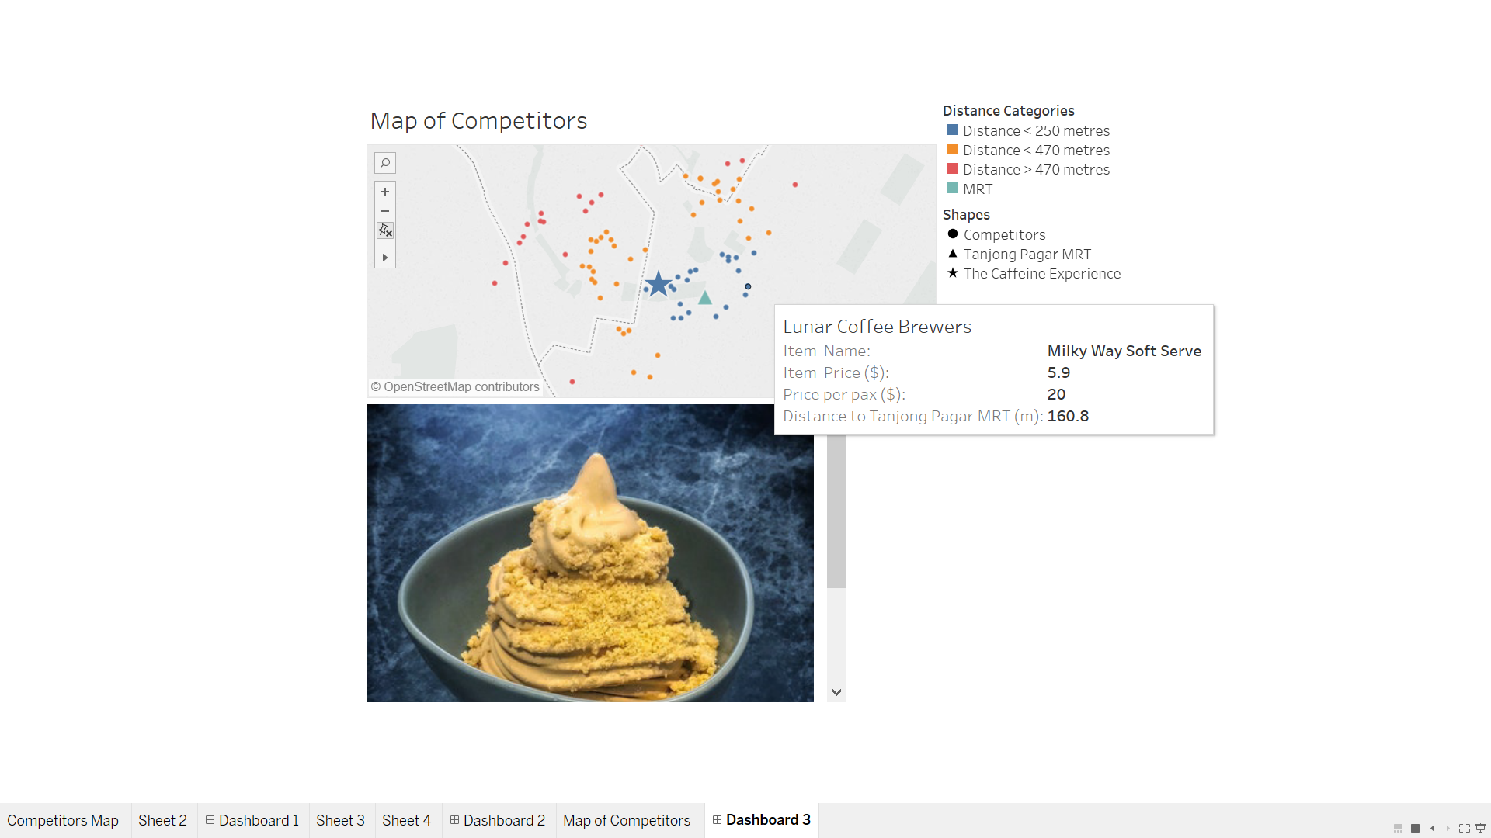

Slide 31
Demonstration
How was the distance calculated?
3) Run it through distance formula
2) Extract latitude and longitude
1) Geocode location names

Slide 32
Demonstration
Purpose of the visualisation
This map illustration aims to allow the end user to have an idea of how The Caffeine Experience fares against its competitors in terms of:
Popularity
A higher number of reviews indicates a greater popularity for the restaurant
Convenience
Distance from the Tanjong Pagar Mrt would be an accurate measure of convenience
Price
Price per pax is used here to gauge the amount of money customers are willing to pay

Slide 33


Thank you very much for your time

Slide 34
Appendix

Slide 35
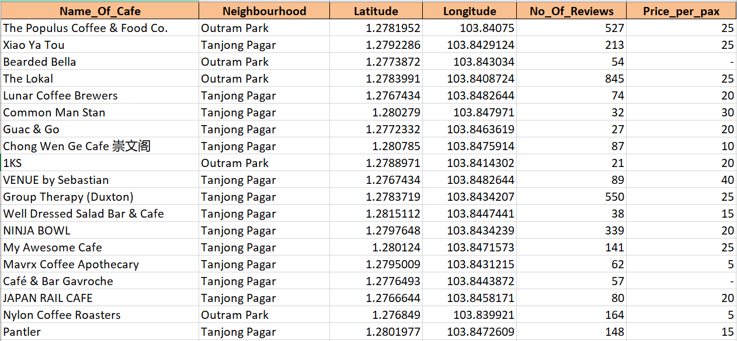
Individual Cafe’s Data

Slide 36
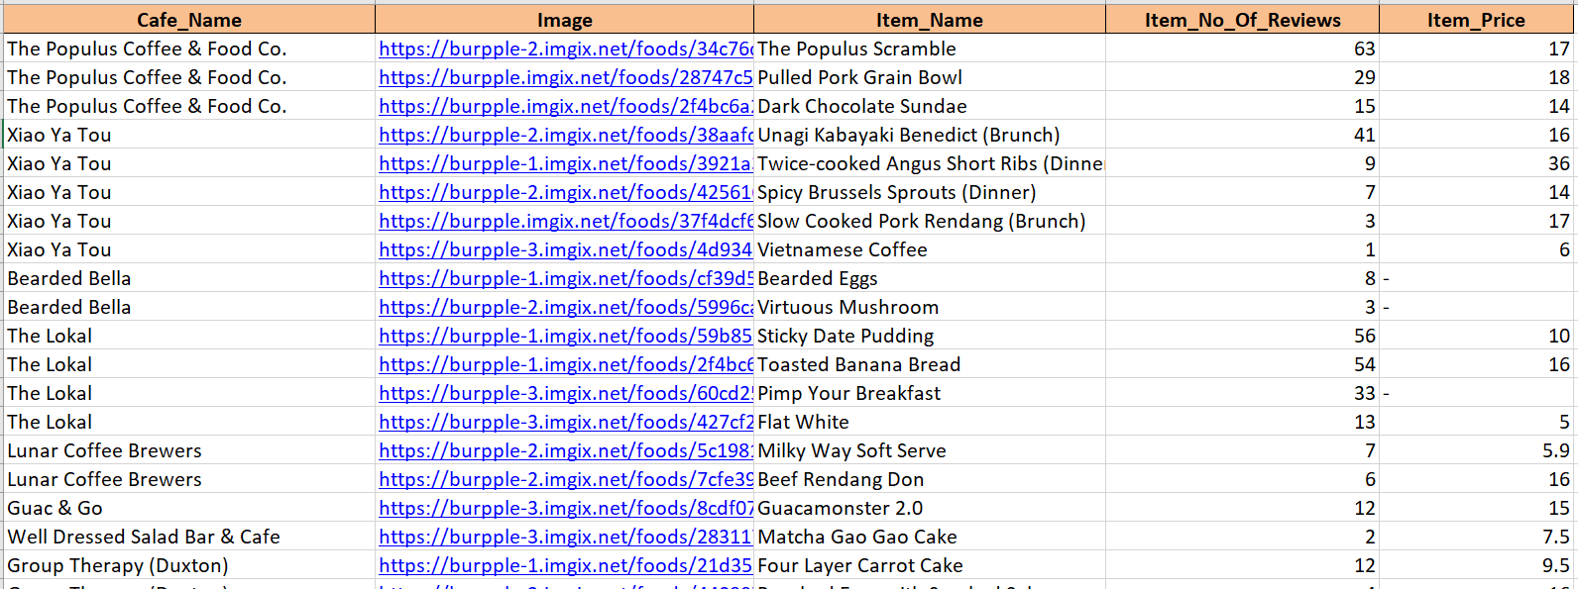
Cafe’s Must Order Item

Slide 37
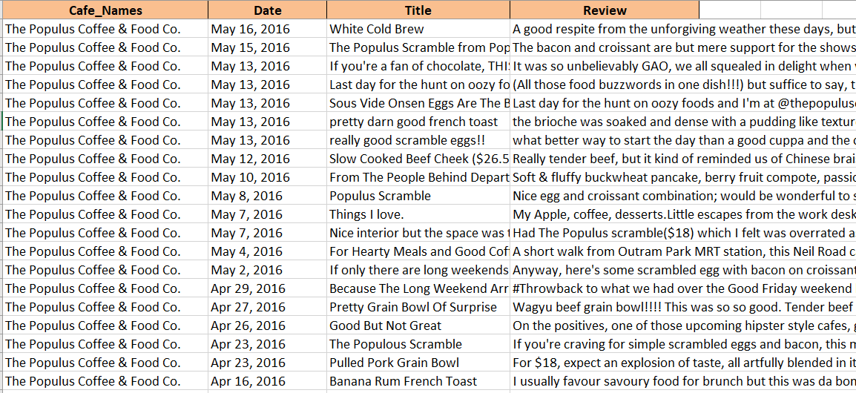
Respective Cafe’s Review

Slide 38
SlidesCarnival icons are editable shapes.
This means that you can:
Resize them without losing quality.
Change line color, width and style.
Isn’t that nice? :)
Examples:

Slide 39
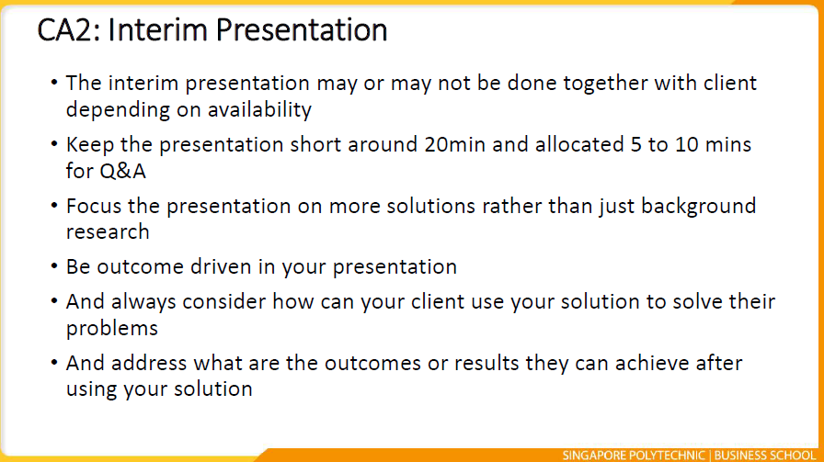
Archive (just for reference)

Slide 40
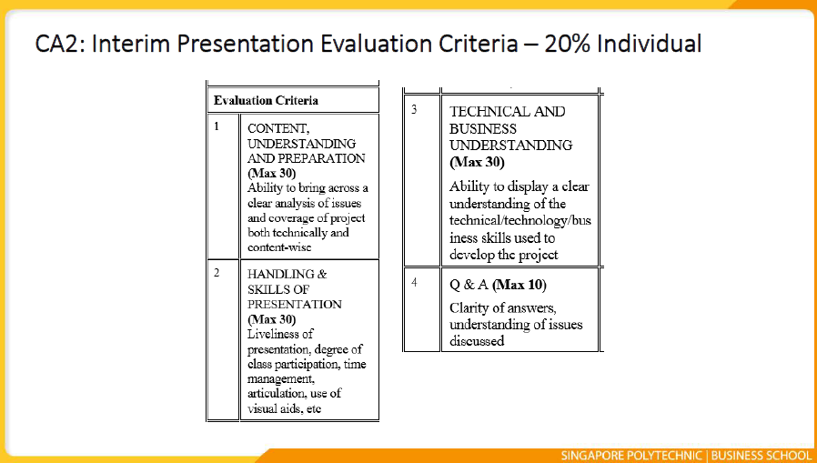
Archive (just for reference)

Slide 41
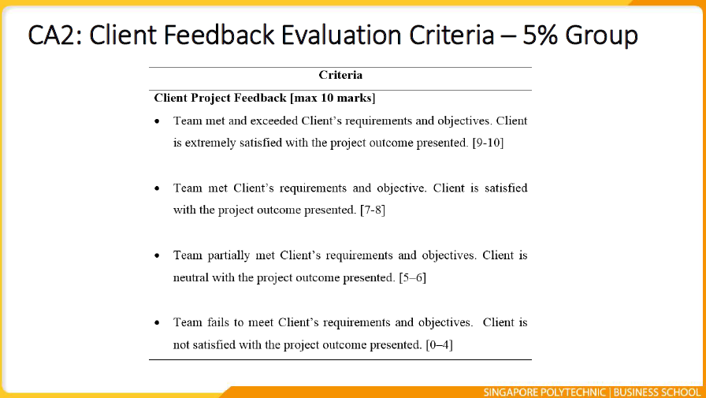
Archive (just for reference)

Slide 42
Not counted (for own reference only)
Data Analysis
Start off by talking about passing the role blah blah (getting data then analysing it)
Talk about how the data cleaned?
How to differentiate between direct and indirect? (focus)
Relevancy using Mapping (will need to ask donovan) (tg vs cbd)
Keywords (eg. coffee, salad most mentioned as keywords (?)
Range of (price per pax) closest to caffeine experience (and which cafe)
Methodology used to differentiate: (briefly mention bc they prob get bored anyways)
Finding keywords using TF-IDF
Mapping (mention donovan will explain more on this)
Simple loops and foops using for loops, ifs function
Sentimental Analysis (need to ask jasper)
Maybe use sa to give keywords more context?
Eg. keyword = coffee, sa = -3 means the coffee might be bad
But another qn is: why not rely on rating instead?
Lotsa grey area
Other insights:
Competitor’s strengths (gives direction on positioning proposition)
Where they stand (in terms of rating) when compared to competitors

Slide 43
TF-IDF
Data Analysis
Methodology
Term Frequency (TF)
Finds the no. of times in which a word appears
TF(t) = (No of times a term appears) / (Total number of terms)
Inverse Document Frequency (IDF)
Measures how important a term is
IDF(t) = log_e(Total number / Number of documents with term t)
Less Emphasis on Common Terms
E.g. “That”, “is”, “was”
More emphasis on important words
E.g. “coffee”, “Salad”
Notes:
No need to include the formula and stuff, just mention the bottom part and say what kind of output.

